Slide 1

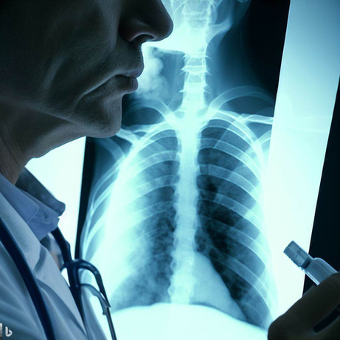


Pneumonia diagnosis system
Under Supervision of
Dr. Ibrahim Zaghloul

Slide 2

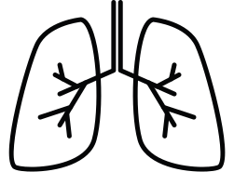











Project Team
Mohamed Hosney Mosad Nasser
Abdelrahman Mohamed Khalil Afkar
Sherif Ashraf Ahmed Roshdy
Yahia Zakaria Ibrahim
Sopeh Salah Sopeh
Abdelkhalek Ashraf Shams
Aya Adel Mohamed Saber
Abdalla Ibrahim Wahuman

Slide 3








CONTENT
overview of the project
Dataset
that used
Deep learning
(CNN) models
system design
API using flask

Slide 4
overview of project
Project motives
project idea
Solutions already in the field and what we will add
System software diagrams
open source used libraries and frameworks

Slide 5

PROJECT MOTIVES
Pneumonia is a leading cause of death in children and the elderly people around the world.
Chest X-rays are the most thorough method of detecting pneumonia because:
It's the cheapest way.
No direct contact with the medical staff.
Due to an erroneous diagnosis and treatment, a person died because of the inconvenient method of diagnosing pneumonia.
It is now possible to construct an autonomous system for identifying pneumonia and treating the condition, especially if the patient is in a distant area with few medical services

Slide 6

PROJECT IDEA
We will be using Deep Learning Algorithms to detect Pneumonia cases (Normal, Pneumonia, Covid-19) in this project. There are different methods to diagnose Pneumonia using Chest X-Ray images, but we'll examine different algorithms, test overall accuracy, and select the best algorithm for detecting Pneumonia.
We'll use Flask and HTML to create a Web app to view the results after choosing the best algorithm from the pre-trained ones.

Slide 7


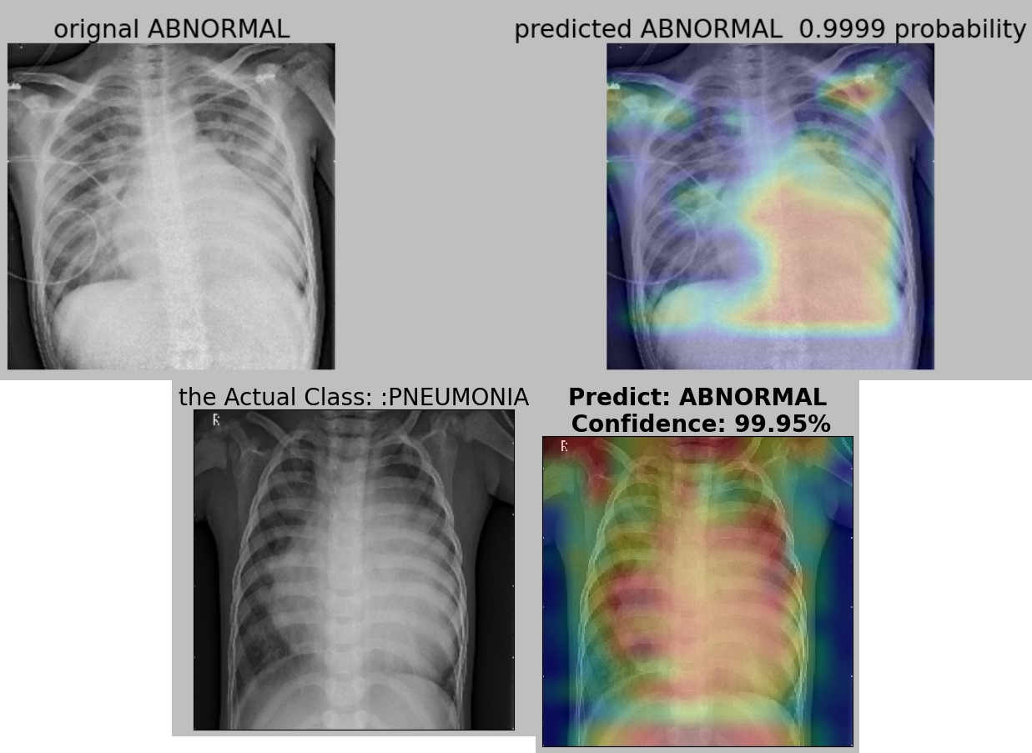
Solutions already in the field of pneumonia detection
Pneumonia doctors can detect this case if it is (NORMAL or ABNORMAL) but cannot detect ABNORMAL cases which it suffering from.
The ABNORMAL case would be pneumonia or covid-19 but the doctor cannot know this difference

Slide 8
BLOCK DIAGRAM OF THE SYSTEM
Select X-ray image. (Reading the datasets)
Image preprocessing (clean image data for model input)
Augmentation (Rescaling, zoom range, horizontal flip)
CNN Model.
detection of disease (Normal, pneumonia, Covid-19)
visualization the Result with Grad-CAM

Slide 9









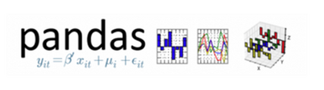


open source used libraries and frameworks

Slide 10
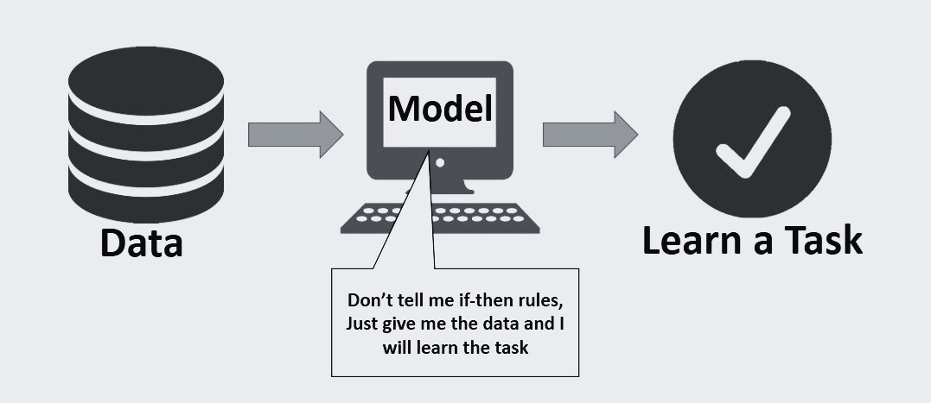
2) Dataset that used

Slide 11
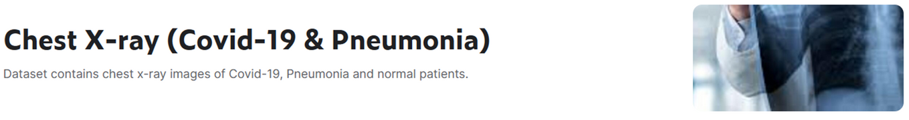
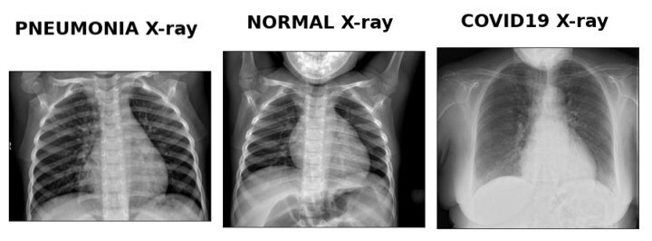
About Dataset
from Kaggle

Slide 12
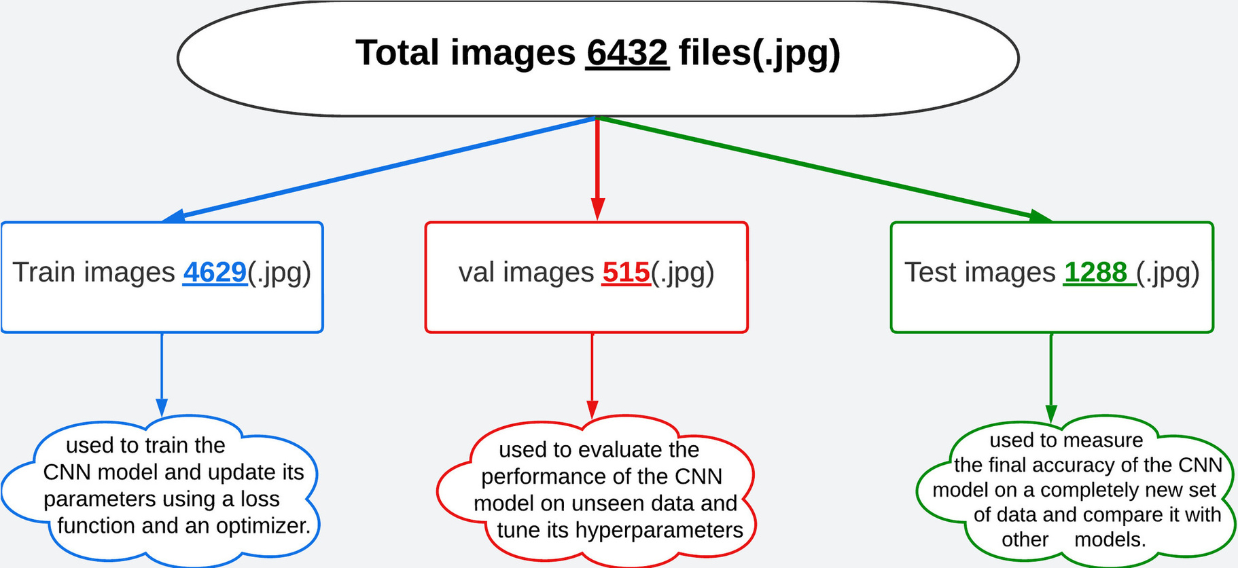
Splitting the dataset

Slide 13
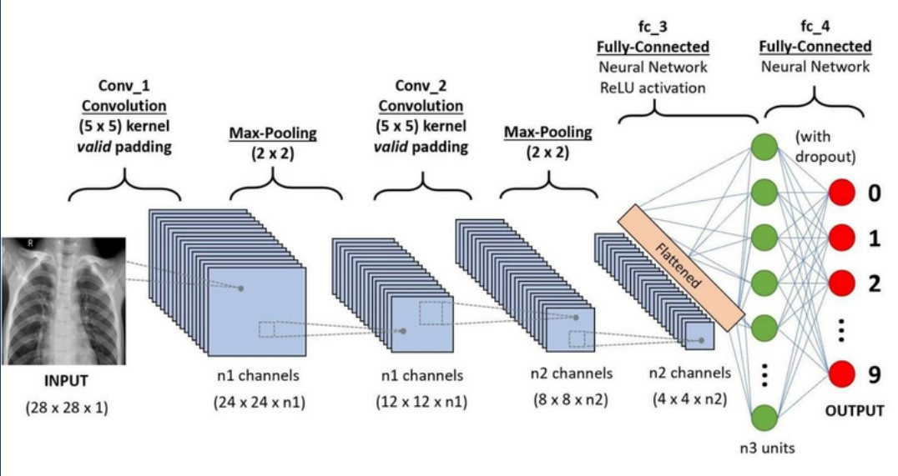
3) Deep learning (CNN) models

Slide 14
Accuracy of All models

Slide 15
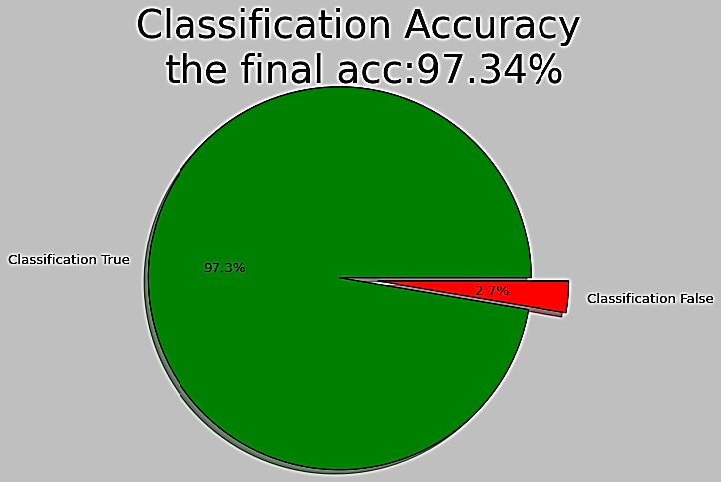
Accuracy score for the best model

Slide 16
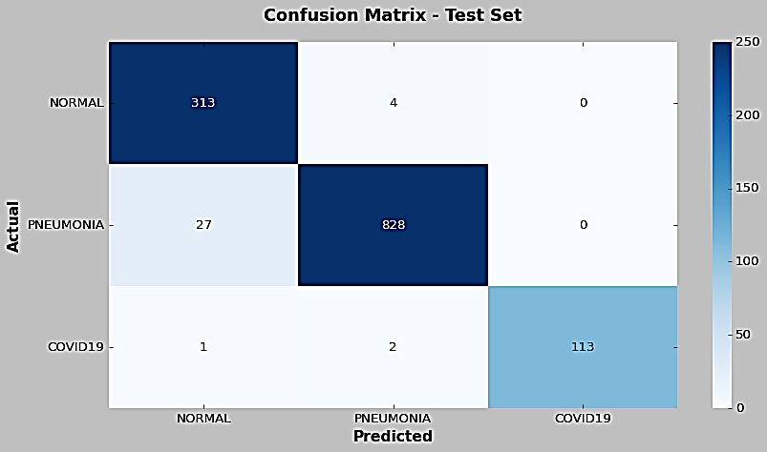
Confusion Matrix for the test dataset

Slide 17


From Confusion Matrix
total 1288 test images
1254 correct matches
34 wrong matches

Slide 18
Classification Report
classes | precision | recall | F1-score
normal | 0.89 | 0.91 | 0.90
pneumonia | 0.97 | 0.96 | 0.96
covid19 | 0.99 | 0.97 | 0.98

Slide 19
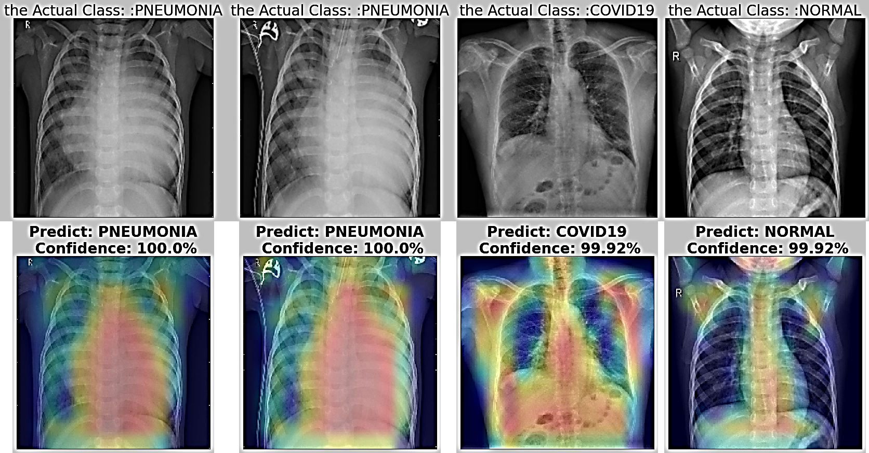

very good Prediction of results

Slide 20
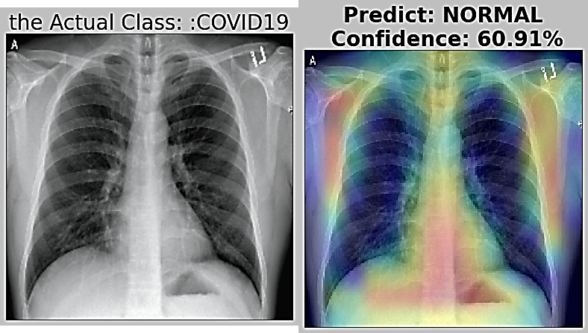

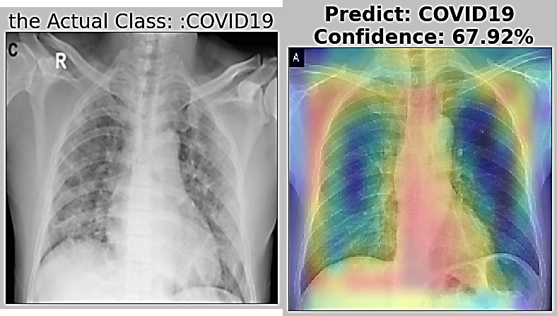

Bad Prediction of results

Slide 21
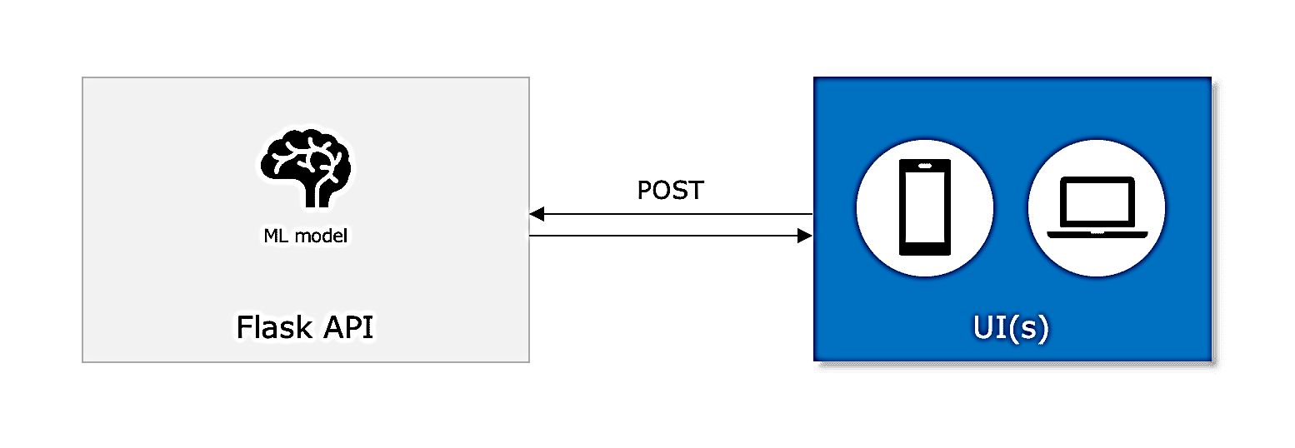
4) API using flask

Slide 22
5) website design
The title of our site is
(Pneumonia System)
the site is divided into eight pages
-------------------------------
each page has a specific function or purpose, and each page will be presenting and how to deal with it without errors.

Slide 23
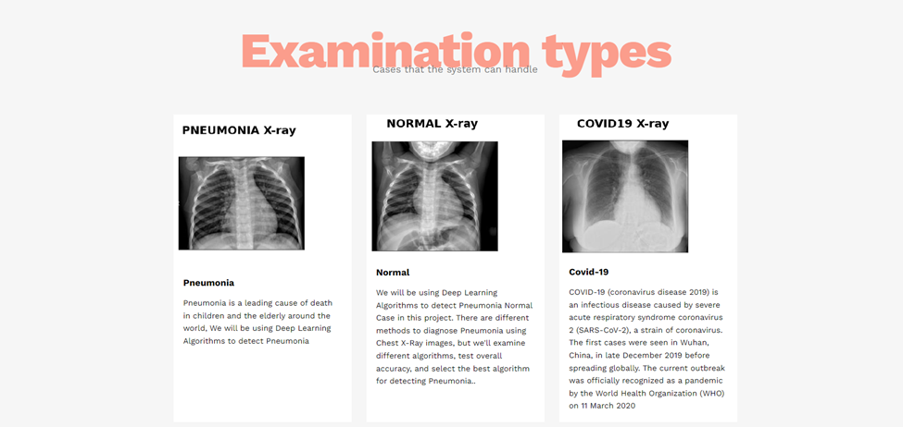

1- The Home page
The Home page in our system consists of a header that contains a button to access the registration and login page in the system and also many small articles that talk in detail about the entire project and the general idea that the project deals with and also contains a part containing contact information with the administrators of the system.

Slide 24
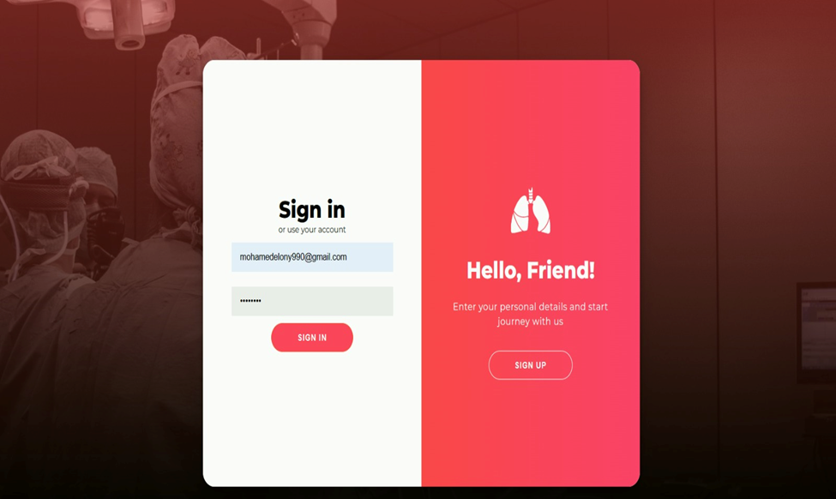
2- sign in
The page consists of two parts, the part on the left contains two fields, one for writing the email and the second for writing the password, and then you press the Sign In button. As for the part on the right, it contains the Sign Up button, to be directed to the Sign Up page.

Slide 25
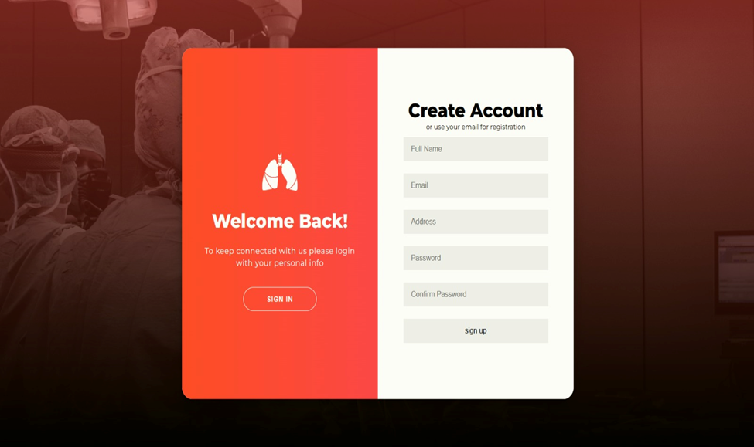
3- Sign Up Page
On this page, you can create a new email to start accessing the special services

Slide 26
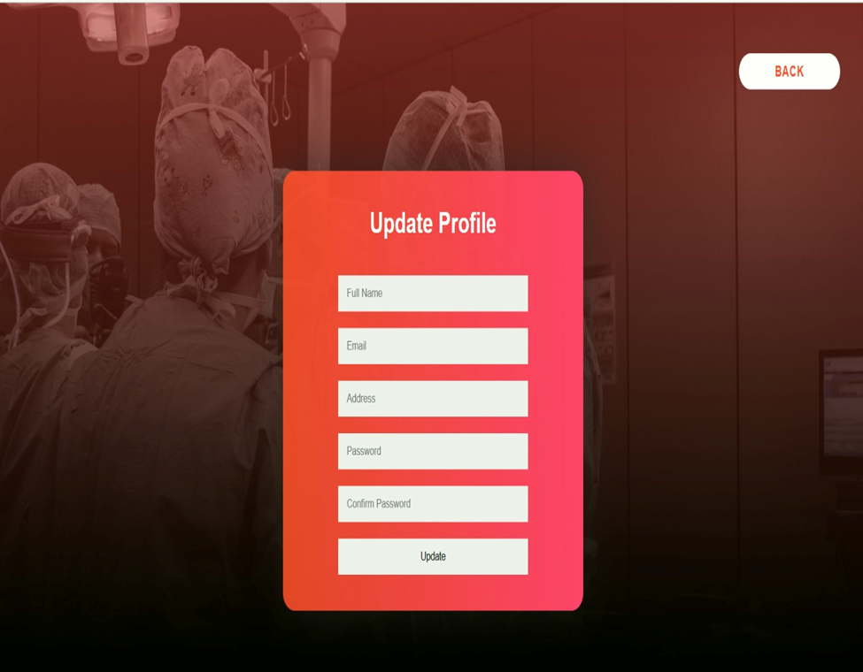
4- Update Profile Page
On this page, you can edit your email information.

Slide 27
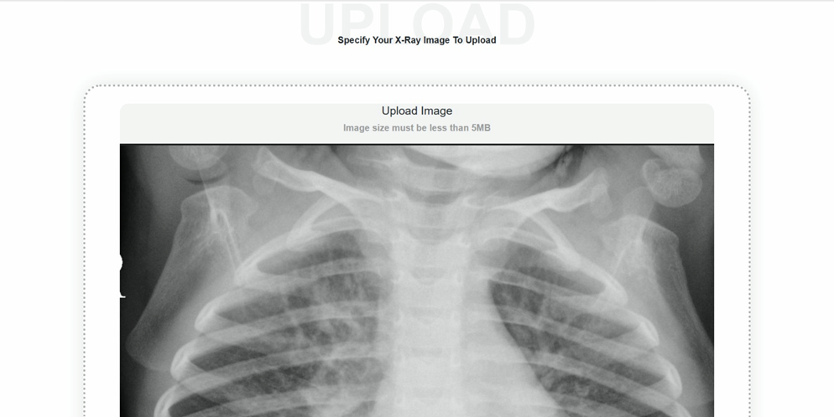
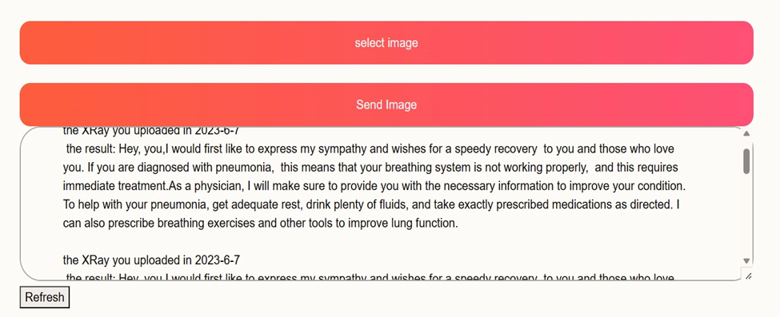
Upload Photo Page
On this page, you can upload your
x-ray image to the system to be examined

Slide 28
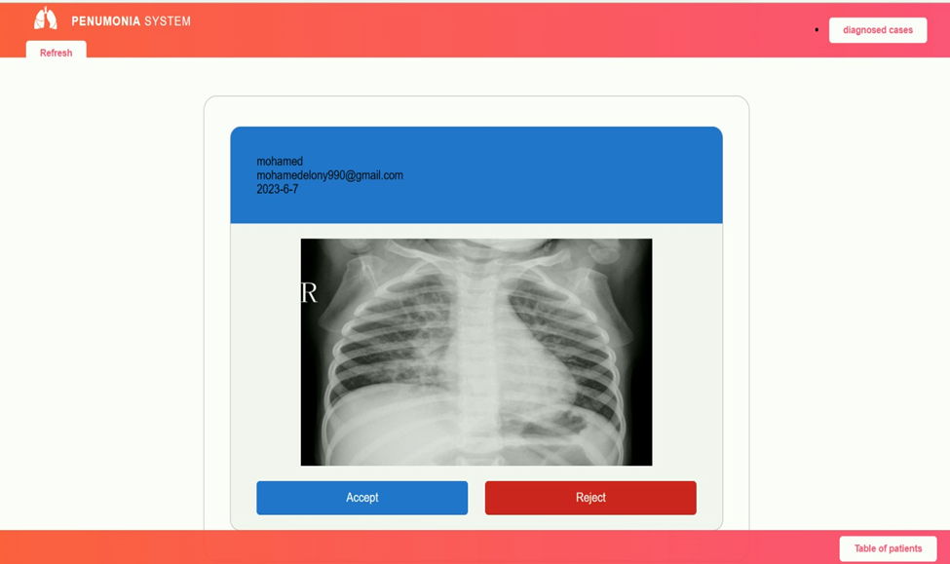
5- Admin Page
On this page, the controller is the admin, and this page can be called the undiagnosed cases page

Slide 29
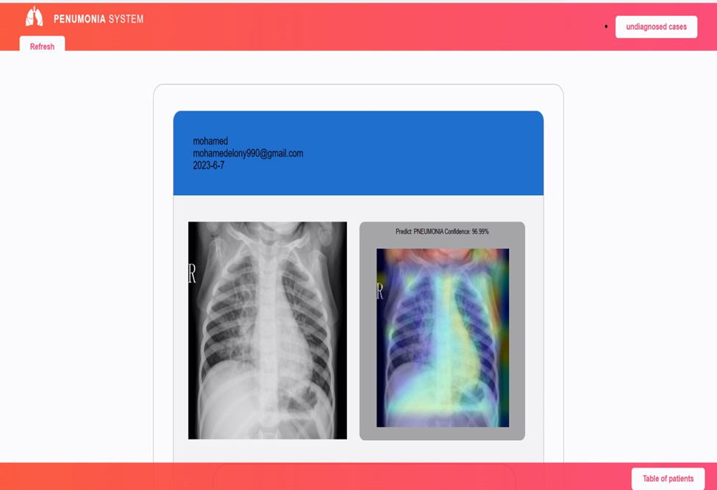
Diagnosed Cases Page
On this page, the x-rays that have been examined are saved to be sent to the patient's e-mail

Slide 30
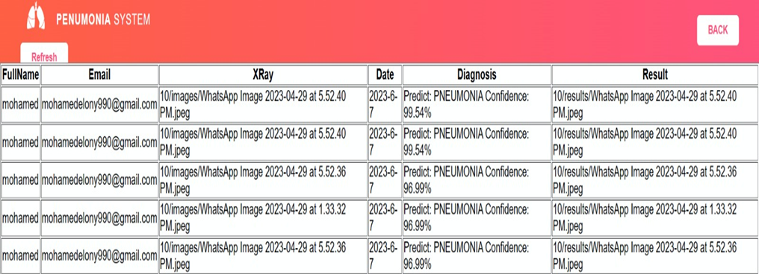
Table Of Patients
On this page, the data of all the cases on the system are displayed

Slide 31
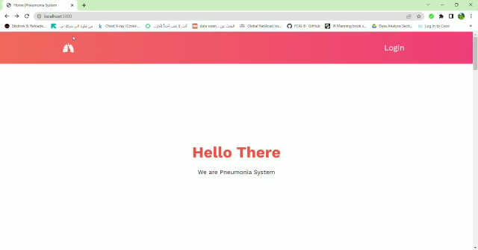
video as “user” of system

Slide 32
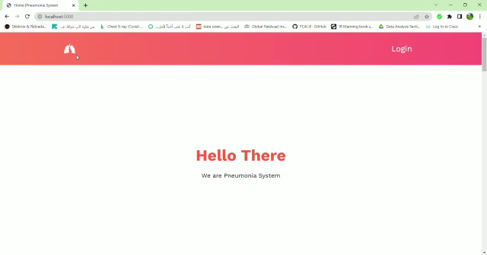
video as “Admin” of system

Slide 33
♥♥ Thank you ♥♥

